Slide 1
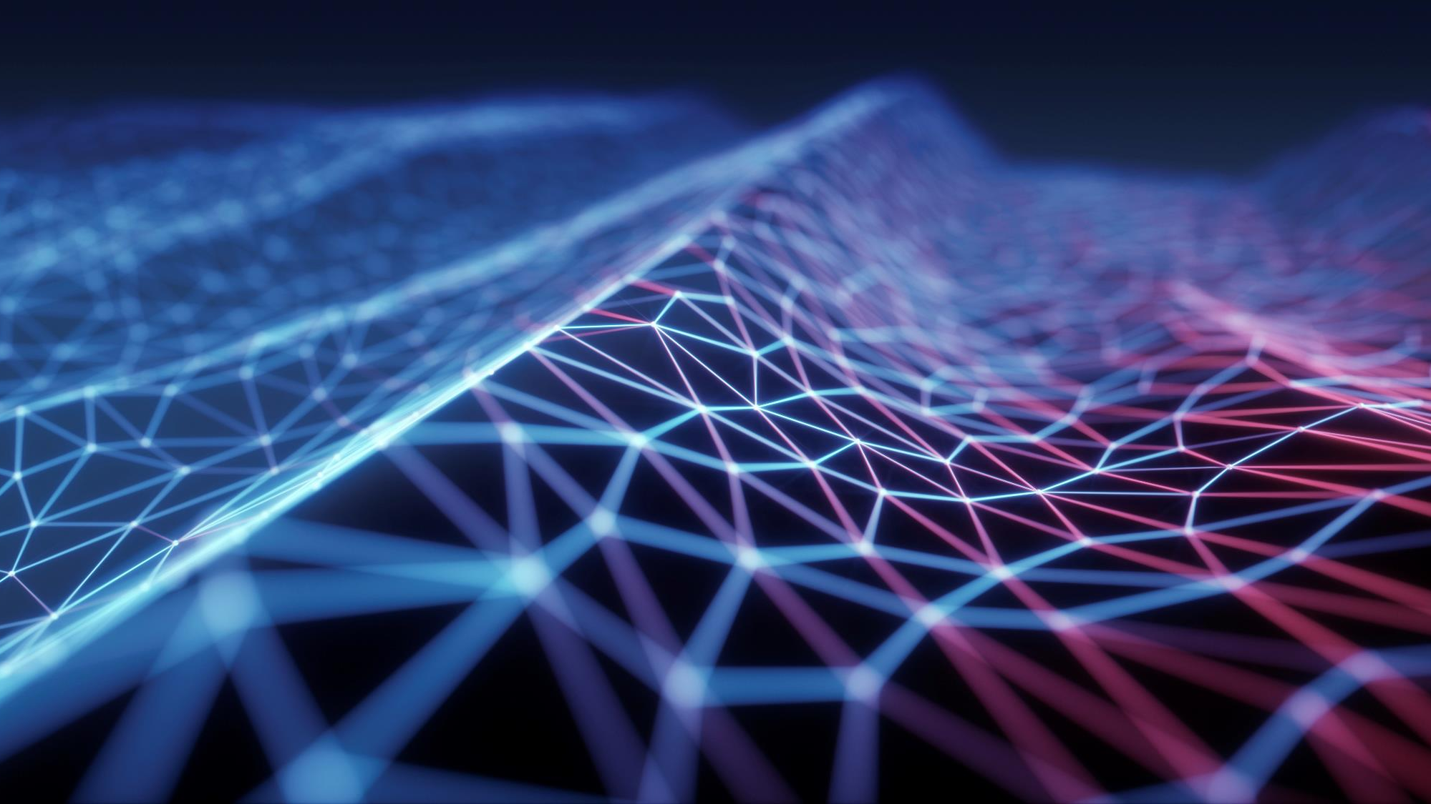
Masterclass - Natural language processing(NLP)
Presenter –
MUSKAN RATHORE
(DATA AND APPLIED SCIENTIST, MICROSOFT)
Notes:
I am working as a data and applied scientist at Microsoft since 2 years. Before that I did my post grad in CSE from IIT Kanpur in 2022. At Microsoft, I am currently working on building ASR models for Indian Local Languages. These ASR models are used in MS products such as Bing, Jio, MG etc

Slide 2
Natural language
Human language is a human constructed system to communicate
Very complex – sarcasm, metaphors, idioms etc
Ex: “I feel ablazed in this heat”, “This was a banging performance”, “You are literally the best person ever”, “He set the stage on fire”
Natural language processing is a field of science and engineering focused on the development and study of automatic systems that understand and generate natural (that is, human,) languages.
Current NLP systems are still far from learning language even close to human learning
Few applications: Machine Translation, Summarization, Generating text similar to a particular writing style (For ex: Generating your own version of Harry Potter or Shakespeare), Emotion detection, QnA (Like Chat GPT)
DATA
Information
Notes:
Human children, interacting with the world and various forms of feedback, acquire language with exceptional sample efficiency and compute efficiency (brains are efficient computing machines!) With all the (impressive!) advances in NLP in the last decades, we are still nowhere close to developing learning machines that have a fraction of acquisition ability of children. One fundamental (and still quite open) problem in building NLP machines is the question of representation; how should we represent language in a computer such that the computer can robustly process and/or generate it? Much of this course will be dedicated to this question of representation, and the rest of this note will talk about a basic sub-question: how do we represent words? Before that, though, let’s briefly discuss some of the applications :

Slide 3
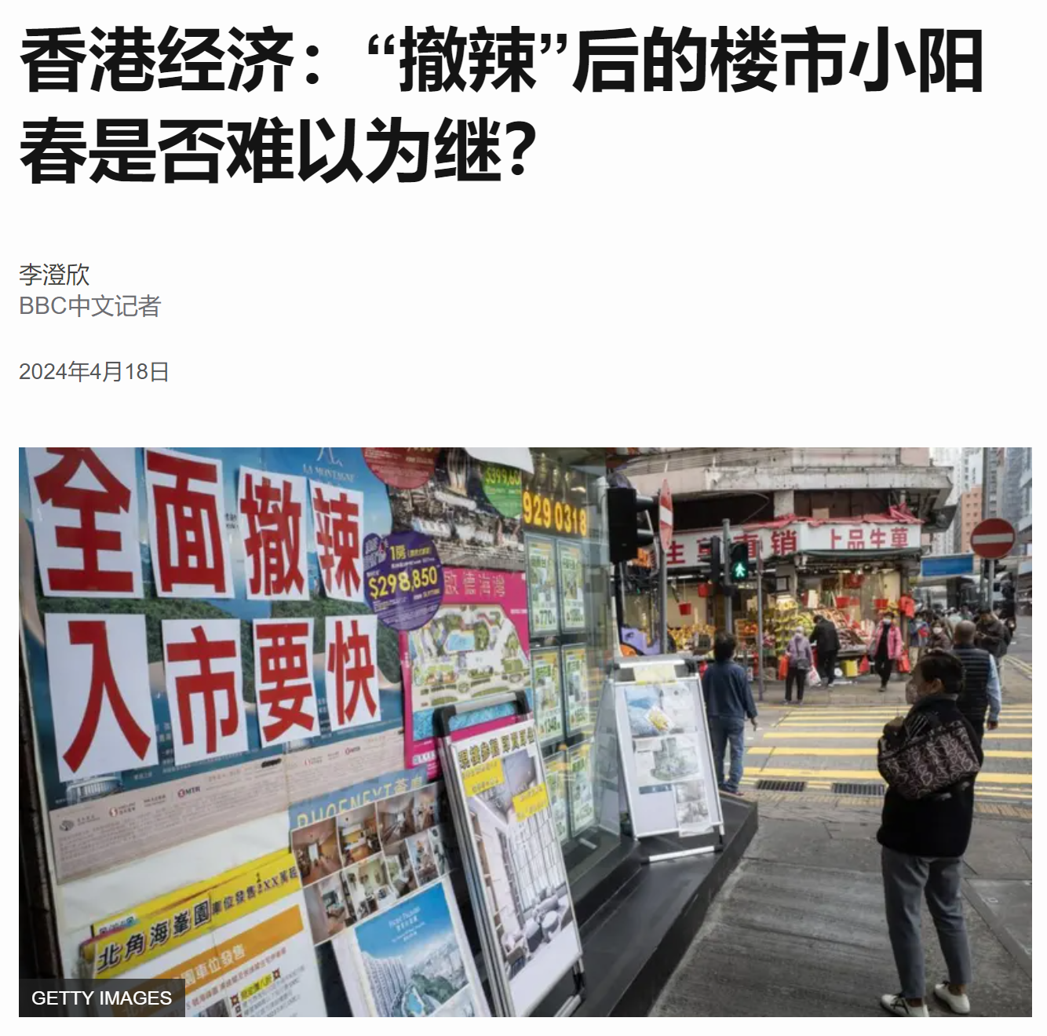
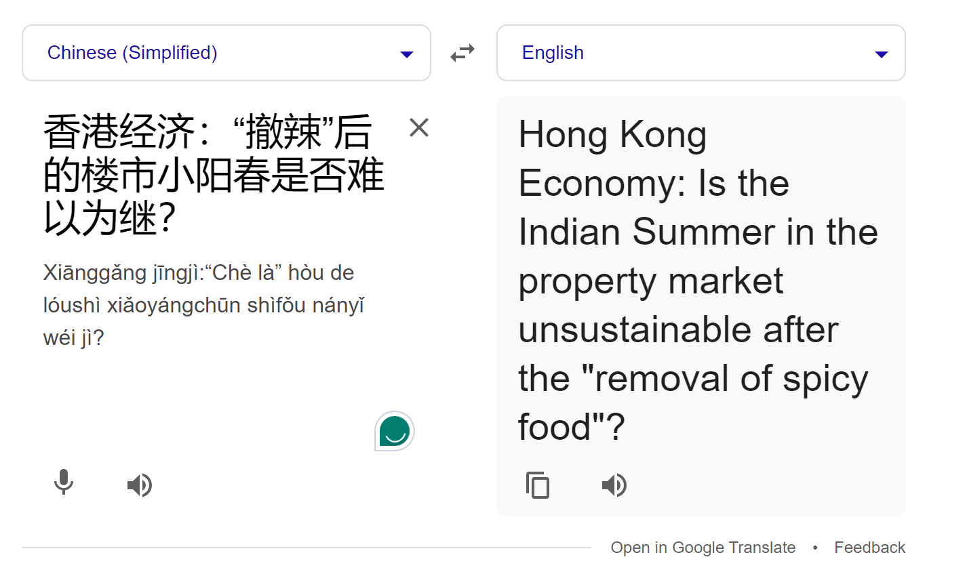
Machine Translation
DATA
Information
Notes:
Converting text in one language to another. Or one form to another
I wanted to check news in China. Saw this post checked headlines in Google’s translate Chinese to English and got the meaning of the headline

Slide 4
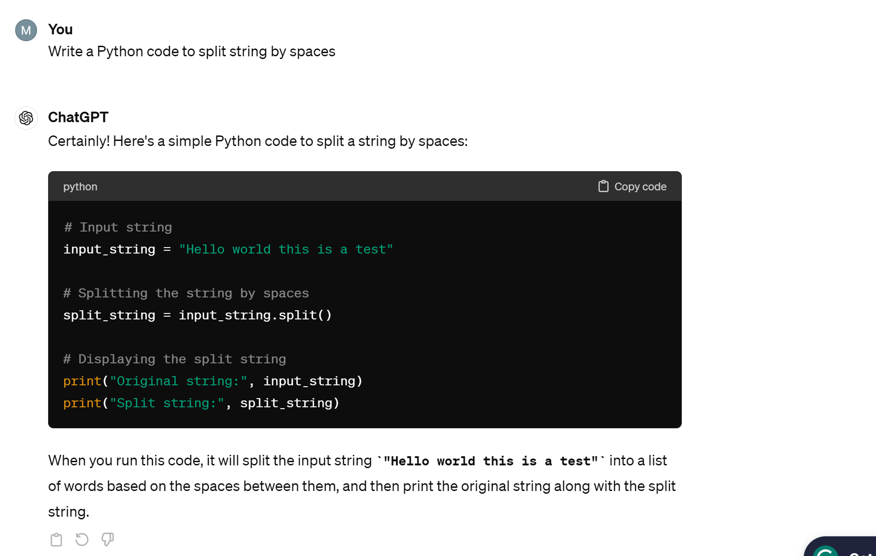
Code generation (comes under machine translation)
DATA
Information

Slide 5
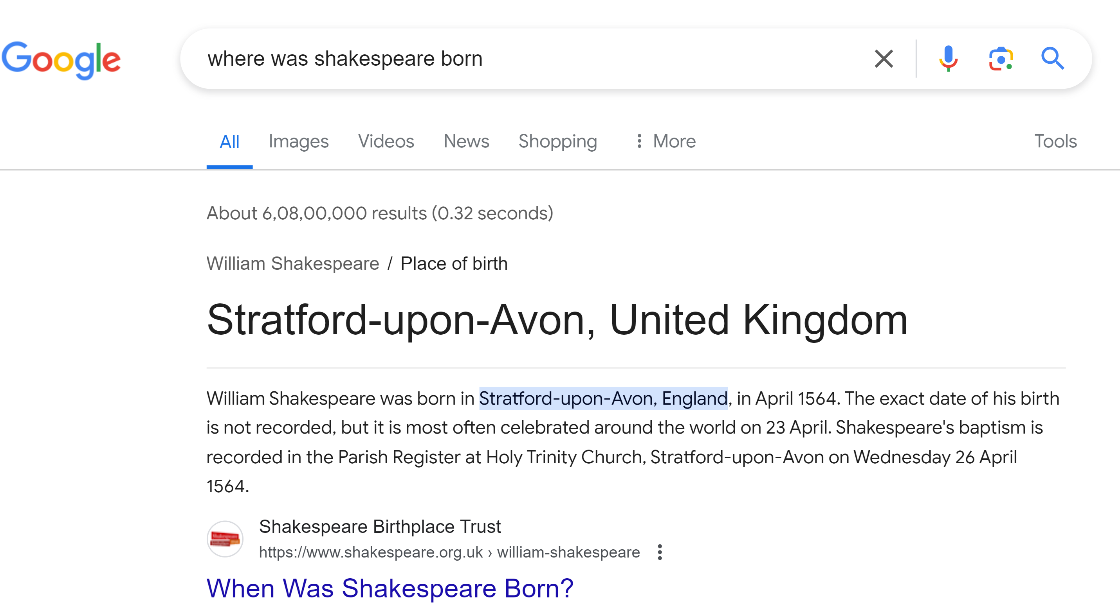
Question and answers
DATA
Information
Notes:
Identifies keywords and based on that tries to look for the keyword answer

Slide 6
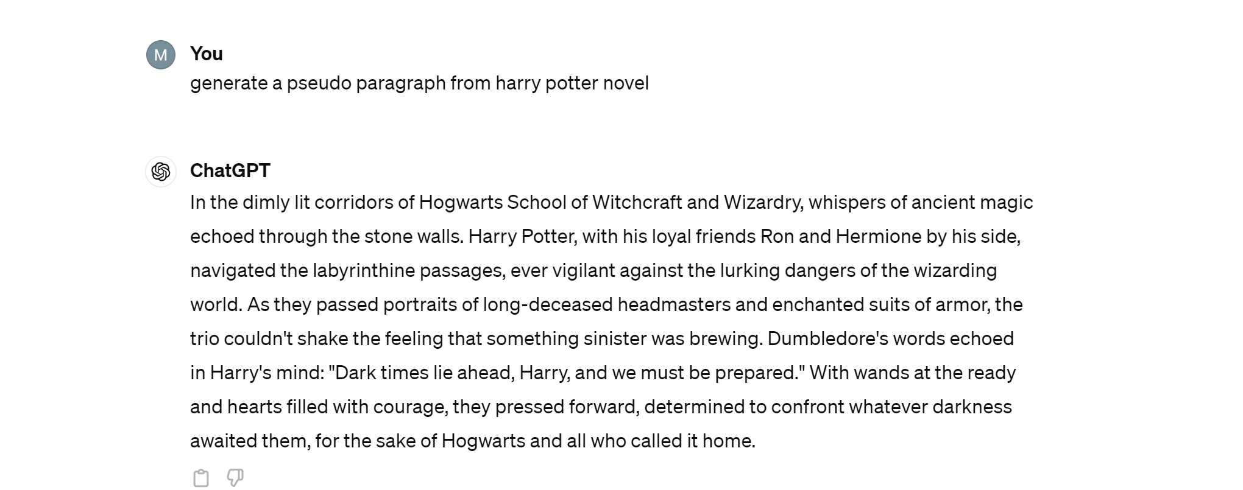
Text generation
DATA
Information
Notes:
Chat GPT is nothing but collection of all NLP applications trained on a huge dataset and is being trained regularly

Slide 7
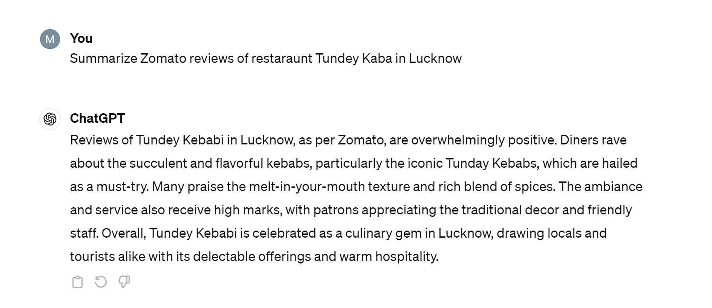
Text summarization
DATA
Information
Notes:
We can see that this line separates images of cats and dogs. ML model essentially tries to learn this line so that whenevr an input image comes, if image is on left of this classifier line will be classified as cat, else dog.

Slide 8

Speech to text or text to speech
DATA
Information
Notes:
Audio -> phonetics->word->sentence

Slide 9

DATA
Information
History of NLP - ELIZA
Notes:
The first generation of chatbots began in 1966 with Joseph Weizenbaum's ELIZA. These basic or rule-based chatbots use algorithms to detect keywords in user inquiries and offer predetermined responses based on them. Because these chatbots lack advanced natural language processing (NLP) capabilities, human language often confuses them. If you can see in the image Eliza is just a therapist who makes you feel like it’s a real person but actually its just predetermined responses depending on the prompt by you. It’s just an illusion that real person is talking.
Many contact centers use these chatbots to help customers find answers to frequently asked questions. To avoid confusion, this technology can offer scripted input buttons to help guide users' inquiries. For example, a customer service bot might offer customers predefined options to select from, such as "Change password," "Order status" and "Store hours." The chatbot then provides scripted responses based on users' selections.
But it was not until 2014, with the introduction of generative adversarial networks, or GANs -- a type of machine learning algorithm -- that generative AI could create convincingly authentic images, videos and audio of real people.

Slide 10
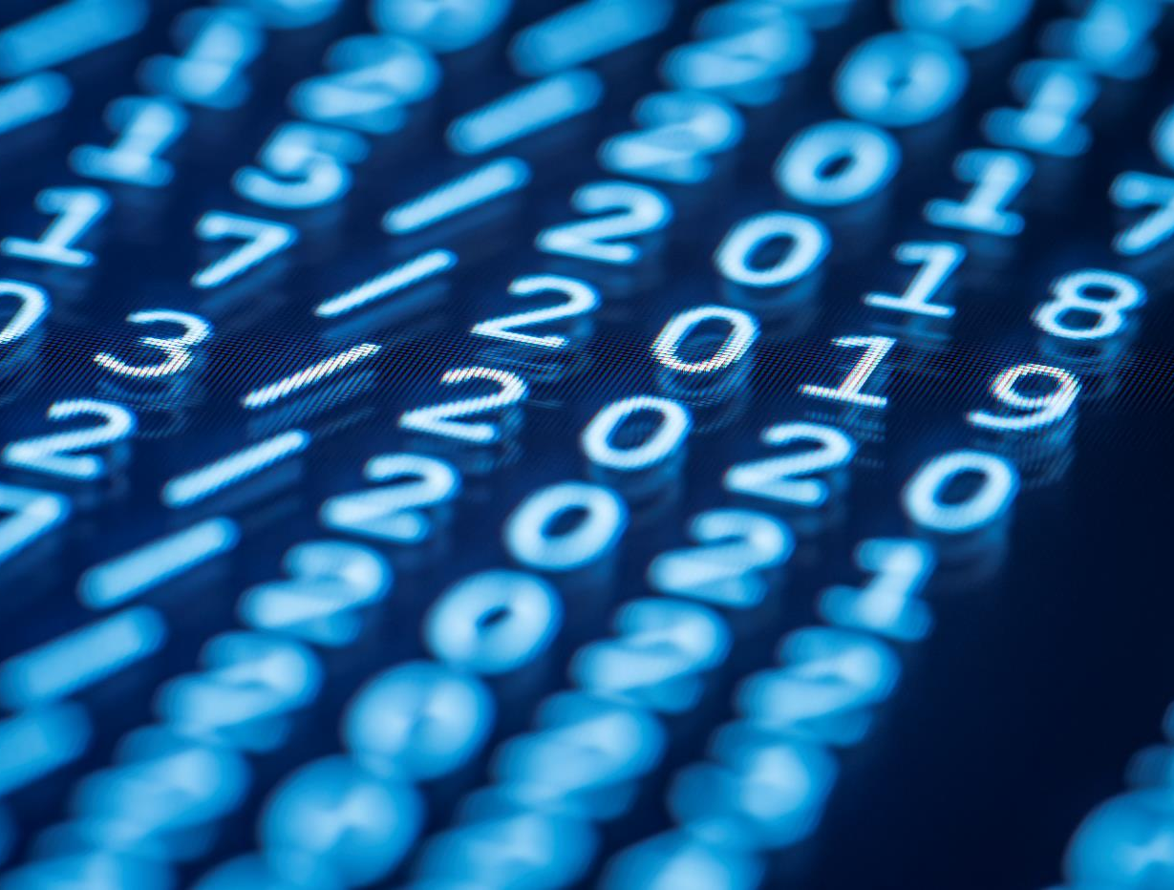
Questions?

Slide 11
Thank you !

